Slide 1
Functions in C++

Slide 2
Functions
Call Type | Description
Call by value | This method copies the actual value of an argument into the formal parameter of the function. In this case, changes made to the parameter inside the function have no effect on the argument.
Call by pointer | This method copies the address of an argument into the formal parameter. Inside the function, the address is used to access the actual argument used in the call. This means that changes made to the parameter affect the argument.
Call by reference | This method copies the reference of an argument into the formal parameter. Inside the function, the reference is used to access the actual argument used in the call. This means that changes made to the parameter affect the argument.

Slide 3
Call by value
#include <iostream>
using namespace std;
int max(int num1, int num2);
int main () {
int a = 100;
int b = 200;
int ret;
ret = max(a, b);
cout << "Max value is : " << ret << endl;
return 0;
}
// function returning the max between two numbers
int max(int num1, int num2) {
// local variable declaration
int result;
if (num1 > num2)
result = num1;
else
result = num2;
return result;
}

Slide 4
Call by pointer
#include <iostream>
using namespace std;
double getAverage(int *arr, int size);
int main () {
int balance[5] = {1000, 2, 3, 17, 50};
double avg;
avg = getAverage( balance, 5 ) ;
cout << "Average value is: " << avg << endl;
return 0;
}
double getAverage(int *arr, int size)
{
int i, sum = 0;
double avg;
for (i = 0; i < size; ++i)
{
sum += arr[i];
}
avg = double(sum) / size;
return avg;
}

Slide 5
Reference operator
#include <iostream>
using namespace std;
int main () {
int a = 100;
int &b = a;
b=200;
cout<<&b<<"\n"<<&a<<"\n";
cout<<a;
return 0;

Slide 6
Call by Reference
#include <iostream>
using namespace std;
void swap(int &x, int &y);
int main () {
int a = 100;
int b = 200;
cout << "Before swap, value of a :" << a << endl;
cout << "Before swap, value of b :" << b << endl;
swap(a, b);
cout << "After swap, value of a :" << a << endl;
cout << "After swap, value of b :" << b << endl;
return 0;
}
void swap(int &x, int &y) {
int temp;
temp = x;
x = y;
y = temp;
return;
}

Slide 7
Return by Reference
#include <iostream>
using namespace std;
int num;
int& test();
int main()
{
test() = 5;
cout << num;
return 0;
}
int& test()
{
return num;
}

Slide 8
Return by Reference
#include <iostream>
#include <ctime>
using namespace std;
double vals[] = {10.1, 12.6, 33.1, 24.1, 50.0};
double& setValues( int i ) {
return vals[i]; // return a reference to the ith element
}
int main () {
cout << "Value before change" << endl;
for ( int i = 0; i < 5; i++ ) {
cout << "vals[" << i << "] = ";
cout << vals[i] << endl;
}
setValues(1) = 20.23; // change 2nd element
setValues(3) = 70.8; // change 4th element
cout << "Value after change" << endl;
for ( int i = 0; i < 5; i++ ) {
cout << "vals[" << i << "] = ";
cout << vals[i] << endl;
}
return 0;
}

Slide 9
#include<iostream>
using namespace std;
void fun(int x, int& y, int* z);
int main()
{
int a = 10;
int b = 20;
int c = 30;
fun(a, b, &c);
cout<<"after function call"<<endl;
cout << a << endl<<b <<endl<< c<<endl;
return 0;
}
void fun(int x, int& y, int *z)
{
cout<<"inside fun"<<endl;
x++;
cout<<x<<endl;
y++;
*z=*z+1;
cout<<y<<endl<<*z<<endl;
}

Slide 10
Function with default arguments
If a function is called by passing argument/s, those arguments are used by the function.
But if the argument/s are not passed while invoking a function then, the default values are used.

Slide 11
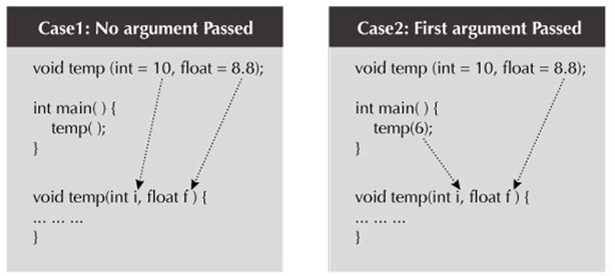
Function with default arguments (contd…)

Slide 12
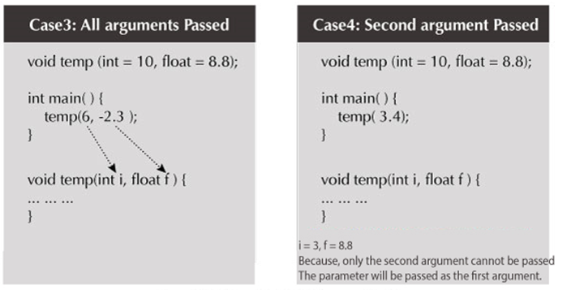

Slide 13
Function with default arguments (Example 1)
#include <iostream>
using namespace std;
void display(char = '*', int = 1);
int main()
{
cout << "No argument passed:\n";
display();
cout << "\nFirst argument passed:\n";
display('#');
cout << "\nBoth argument passed:\n";
display('$', 5);
return 0;
}
void display(char c, int n)
{
for(int i = 1; i <= n; ++i)
{
cout << c;
}
cout << endl;
}

Slide 14
Function with default arguments (Example 2)
#include<iostream>
using namespace std;
int sum(int x, int y, int z=0, int w=0)
{
return (x + y + z + w);
}
int main()
{
cout << sum(10, 15) << endl;
cout << sum(10, 15, 25) << endl;
cout << sum(10, 15, 25, 30) << endl;
return 0;
}

